Slide 1
Informative Speaking

Slide 2

Purpose
General purpose is to inform the audience.
Specific purpose relates to your topic and specific information you want to convey.

Slide 3
Informative Speaking
A speech to inform shares information with others
to enhance their knowledge or understanding of
the concept and ideas presented.
When you inform someone, you assume the role
of a teacher by defining, illustrating, clarifying, or
elaborating on a topic.

Slide 4
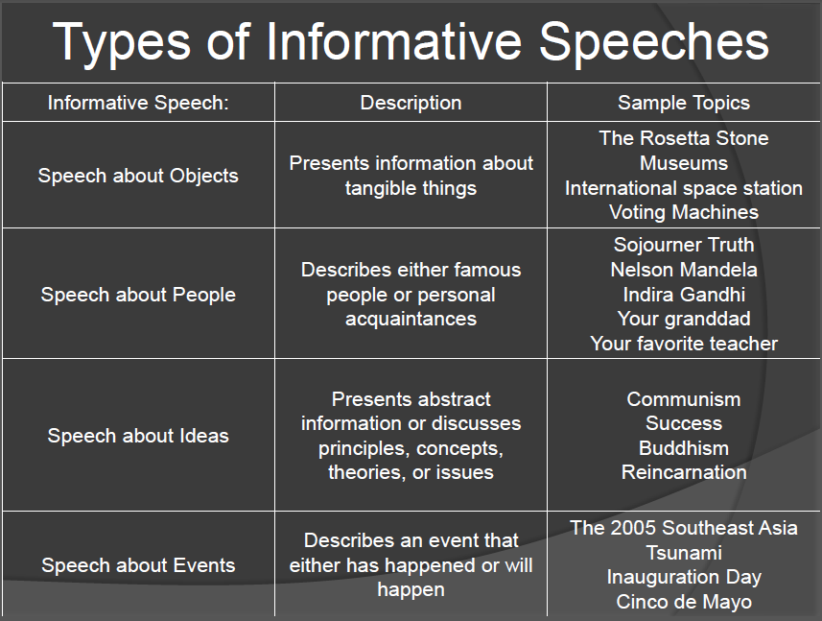

Slide 5
Activity
Label the speech topic with content type
How to change a tire? _____________
Islamism ____________
Forest fires will eventually destroy life on earth _______
Nelson Mandela ____________
Should the world come up with a mutual plan to end the pandemic? _______
Wildflower festival

Slide 6
Goals
Speak to enhance understanding
Speak to maintain interest
Speak to be remembered

Slide 7
Strategies to Enhance Audience Understanding
Preview main ideas in introduction
Tell your listeners how what you present relates to a
previous point
Frequently summarize key ideas
Don’t present too much information too quickly

Slide 8
Strategies to Maintain Audience Interest
Tell a story
A good story includes conflict, action, suspense, and
maybe some humor.
Present information that relates to listeners
For example, if you are talking about recycling be sure to
talk about specific efforts on your campus or in the
community.

Slide 9
Strategies to Enhance Audience Recall
Build in redundancy
Repeat key points
Give a clear preview at the beginning of your talk as
well as a summary statement in your conclusion.
Use numeric signposts (My first point… My second…)
Pace/flow of information
Reinforce key ideas verbally
You can reinforce an idea by using such phrases as “This is
the most important point” or “Be sure to remember this point.”

Slide 10
Strategies to Enhance Audience Recall
Reinforce key ideas nonverbally
A well-placed pause can provide emphasis and
reinforcement to set off a point.
Raise or lower your voice can also reinforce a key idea.
Moving from behind the podium to tell a personal anecdote
can signal that something special is about to be said.

Slide 11
Structure
Introduction
Attention getter
Start with a story or quote
Start with an unusual statement or rhetorical question
Start with humor or shocking statistics
Reveal your topic
Establish Credibility
Audience adaptation

Slide 12
Body
Decide which aspects of that topic are of greatest importance for your speech. These aspects become your main points.
Main Point 1
Main Point 2
Main Point 3

Slide 13
Conclusion
Re-assert/Reinforce the Thesis
Review the Main Points
Close Effectively

Slide 14
“If you don’t know what you want to achieve in your presentation your audience never will.” – Harvey Diamond

